Slide 1
Distance Measures
By
Dr. S PADMANABHAN

Slide 2
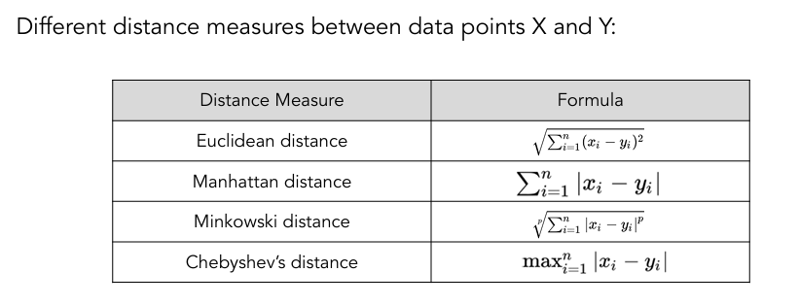
Distance measures

Slide 3
Problem: At the end of 3rd iterations the two clusters formed with the following observation C1: (2,3), (4,5), (1,4), C2: (4,6), (3,5). Compute the Euclidian distance between the updated centroids and the point (4,6) during the next iteration.
To compute the Euclidean distance between the updated centroids of the clusters C1 and C2 and the point (4,6), we need to follow these steps:
Calculate the Centroids of C1 and C2
Compute the Euclidean Distance between each Centroid and the point (4,6)

Slide 4
Step 1: Calculate the Centroids
For C1: (2,3), (4,5), (1,4)
The centroid (xˉ1, yˉ1) is the mean of the coordinates:
xˉ1 = (2 + 4 + 1) / 3 = 7 / 3 ≈ 2.33
yˉ1 = (3 + 5 + 4) / 3 = 12 / 3 = 4
So, the centroid of C1 is (2.33, 4).
For C2: (4,6), (3,5)
The centroid (xˉ2, yˉ2) is the mean of the coordinates:
xˉ2 = (4 + 3) / 2 = 7 / 2 = 3.5
yˉ2 = (6 + 5) / 2 = 11 / 2 = 5.5
So, the centroid of C2 is (3.5,5.5).

Slide 5
Step 2: Compute the Euclidean Distances
Distance between Centroid of C1 and the Point (4,6)
d (C1, (4, 6)) = (2.33 − 4)² + (4 − 6)² = (−1.67)² + (−2)² = 2.7889 + 4 = 6.7889 ≈ 2.61
Distance between Centroid of C2 and the Point (4,6)
d (C2, (4, 6)) = (3.5 − 4)² + (5.5 − 6)² = (−0.5)² + (−0.5)² = 0.25 + 0.25 = 0.5 ≈ 0.71
Conclusion
The Euclidean distances between the updated centroids and the point (4,6) during the next iteration are:
Distance between the centroid of C1 and (4,6): approximately 2.61
Distance between the centroid of C2 and (4,6): approximately 0.71

Slide 6
Distance matrix
In the initial step of clustering, each observation is considered as a cluster
The distance matrix returns the pairwise distance between all these observations
The pairwise distance can be calculated using various distance measures like Manhattan, Euclidean, Minkowski and so on
This matrix is used to find the two closest clusters

Slide 7
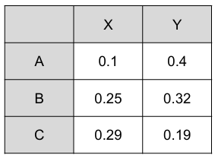
Find the distance matrix for the given data using Euclidean distance.
To obtain a distance matrix, calculate the Euclidean distance between all the points.

Slide 8
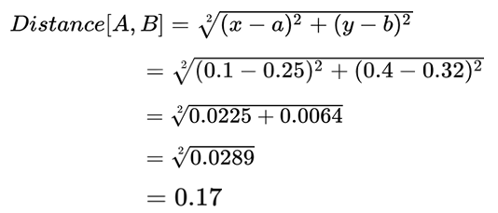
The distance between data points A and B is 0.17.
Similarly we can calculate the distance between all the points.
By calculating all the distances, we obtain the distance matrix.
This matrix returns all the pairwise distances.

Slide 9
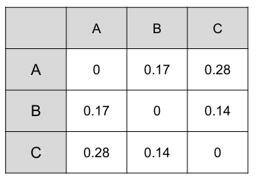
The distance matrix is

